Slide 1
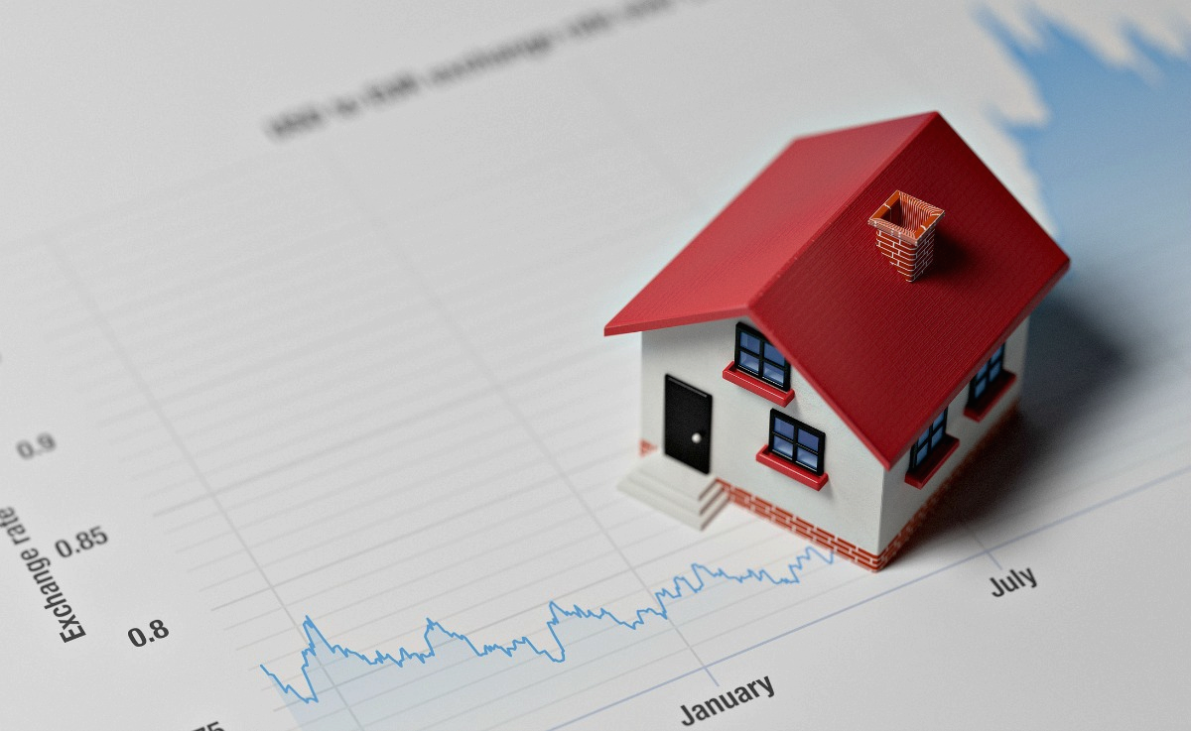
Portuguese Real Estate Market Analysis
Presented by:
Sebastião Ngombo
Shyam Kumar Rana
Marjuk Ahamed

Slide 2
Introduction
Creating an innovative real estate platform that maps available properties, negotiates discounts and fees based on the speed of leasing, and presents clients with the best match of house specifications, prices, and locations. The platform aims to streamline the real estate search process, benefiting both property owners and prospective tenants.
Commission Fees
Subscription Plans
Advertising
Value-Added Services (property management, legal assistance, and financial advisory).

Slide 3

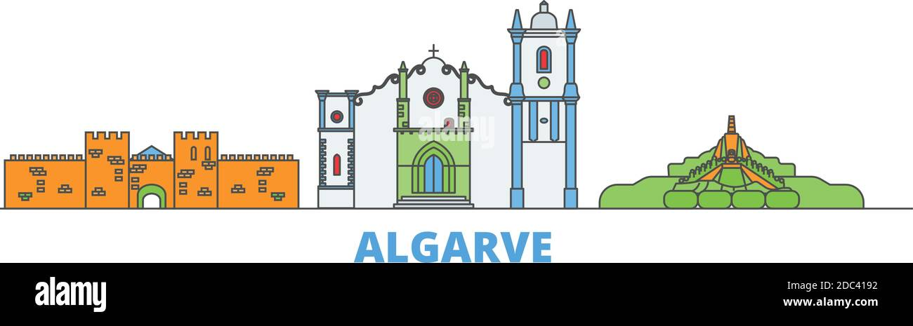



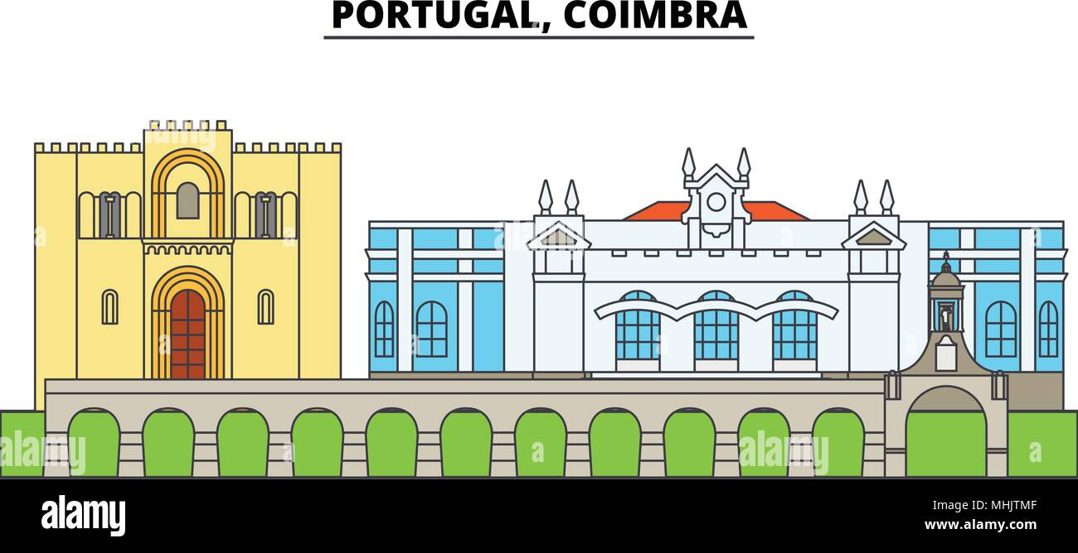
Average House
Price
Coimbra 170k €
Braga 319k €
Aveiro
342k €
Porto
475k €
Faro
734k €
Lisbon
971k €

Slide 4



So expensive?
Study has shown:
Cities with higher average income
Short term rental
Bigger cities has higher price compare to smaller cities
Touristic places
Top ranked universities

Slide 5

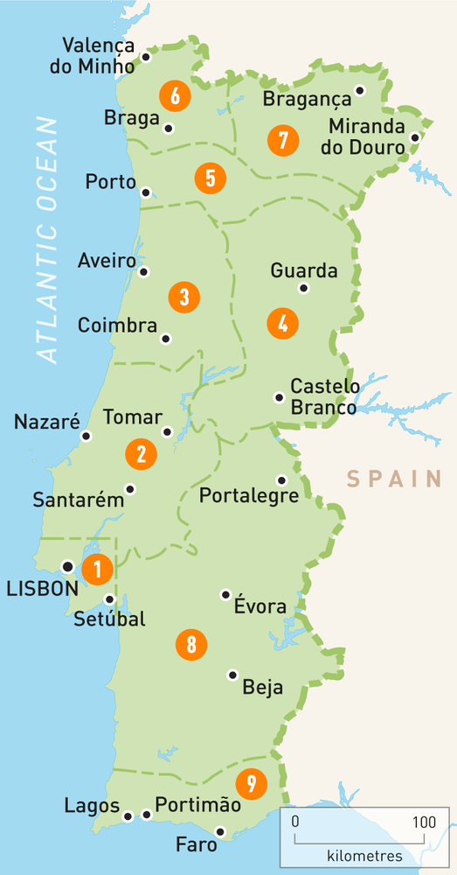
Fancy for a house in any coastal city of Portugal?

Slide 6
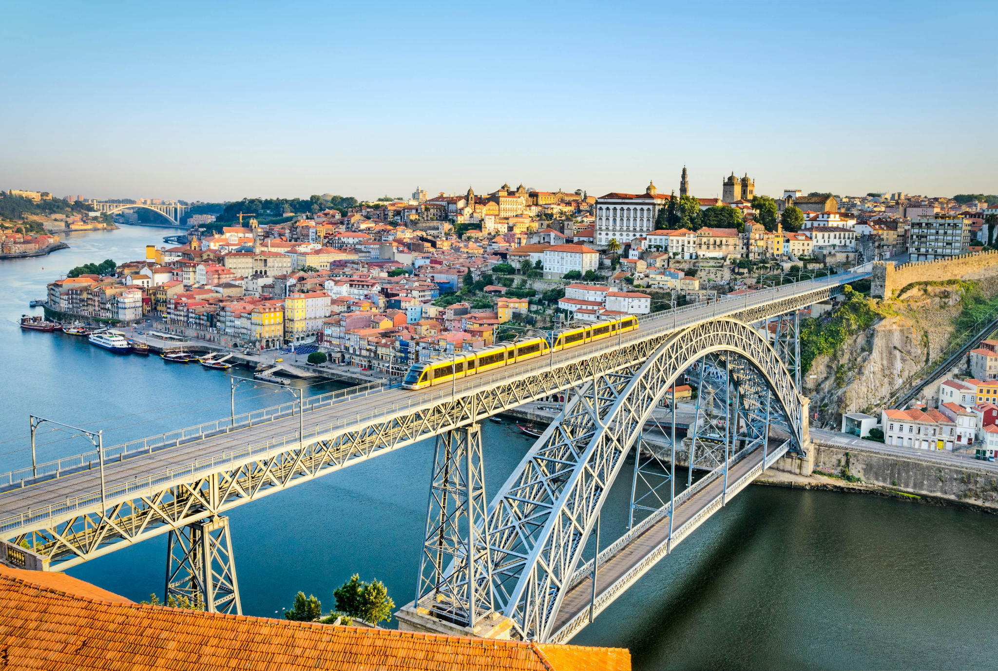
Our analysis shows Porto has lower average price for properties compare to Lisbon and Faro

Slide 7
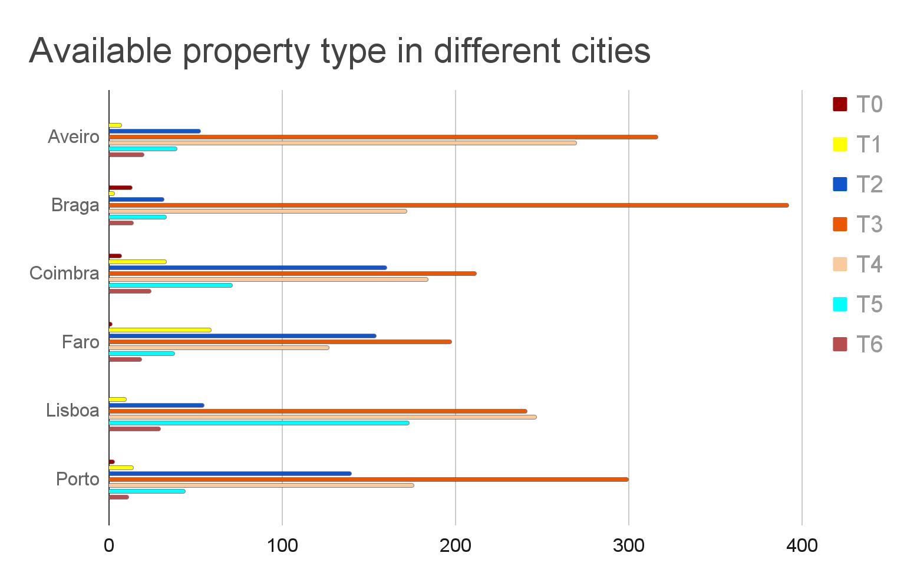

Slide 8
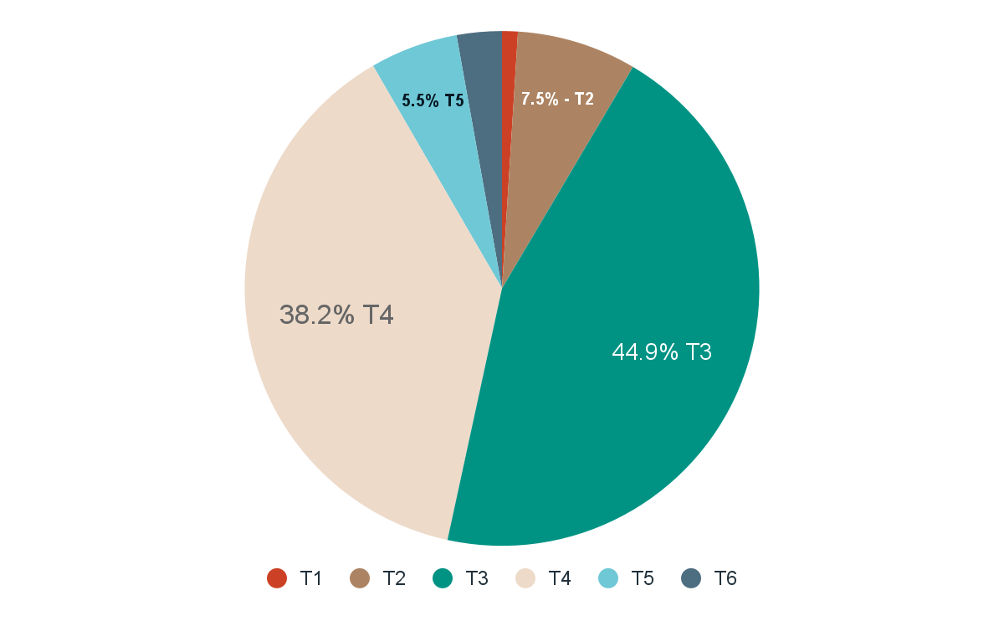
Most Probable Trader In Current Market
Family

Slide 9

“Real estate cannot be lost or stolen, nor can it be carried away. Purchased with common sense, paid for in full, and managed with reasonable care, it is about the safest investment in the world.” -
Franklin D. Roosevelt, U.S. President

Slide 10
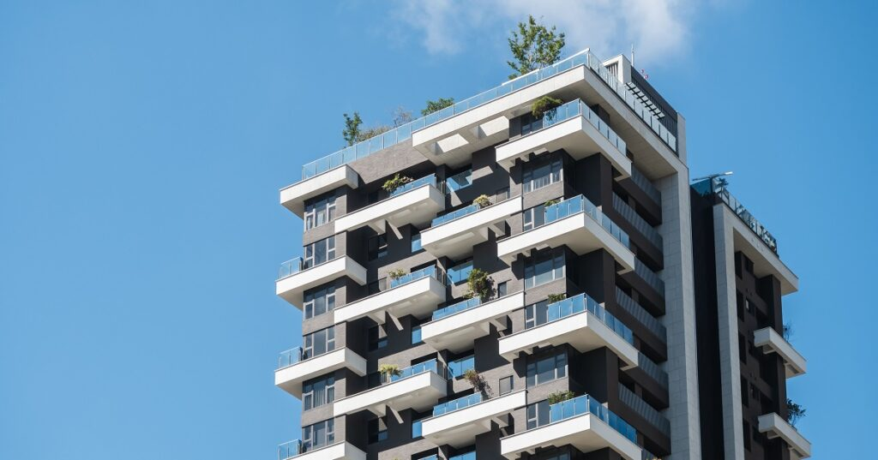
Ad’s Placed last 24 hours in Lisbon
Type | Ads | AVG Price/sqm
T0 | 0 | n/a
T1 | 13 | 1.9k
T2 | 51 | 3.3k
T3 | 231 | 9k
T4 | 222 | 12k
T5 | 100 | 53k
T6 | 35 | 190k

Slide 11
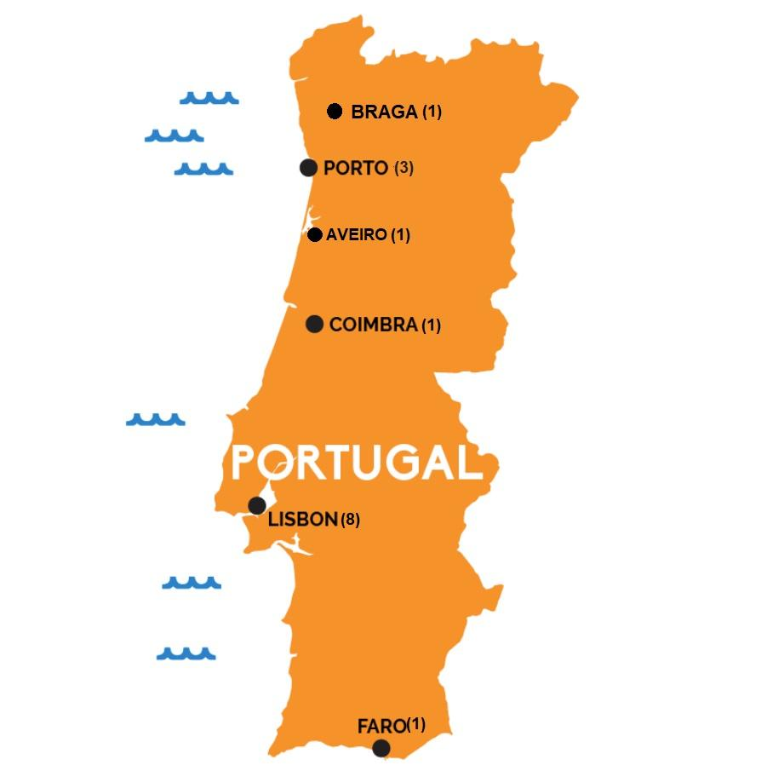
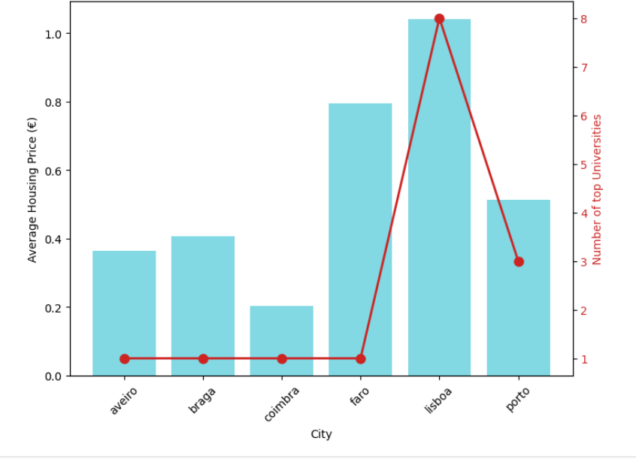
House Prices VS Number of Universities

Slide 12
Thank You!
Portuguese Real Estate Market Analysis.
Presented By -
Sebastião Ngombo
Shyam Kumar Rana
Marjuk Ahamed

